Slide 1

SMART AGRICULTURE USING
ARTIFICIAL INTELLIGENCE
Presented By
Name: Keerthana Reddy
Roll No: 22671A7229
Guide Name:
“D.Damodhar”
Designation
DEPARTMENT OF AIDS&CSE(DS)
J.B.INSTITUTE OF ENGINEERING & TECHNOLOGY

Slide 2
CONTENT
Introduction
Role
Source of data
Models and algorithms
Flow charts and intermediate outputs
Benefits
Source Code
Challenges
Complete details of project
Conclusion

Slide 3
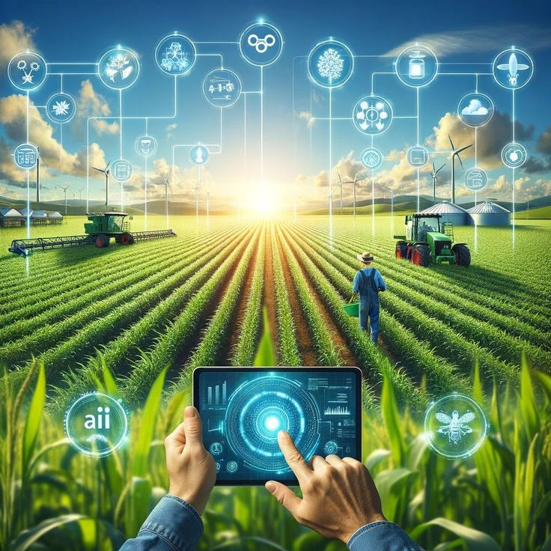

INTRODUCTION
What is smart agriculture?
Smart agriculture or smart farming, is the use of
modern technologies like the Internet of the things(IOT), Artificial intelligence (AI) , Robotics and data Analytics to improve farm efficiency, increase crop Yields and quality.
Why It is needed?
To increase crop yield for a growing population.
To tackle climate change challenges.
To ensure sustainable farming practices.

Slide 4
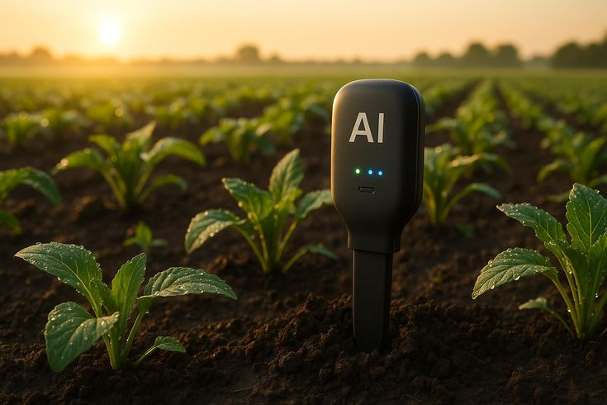
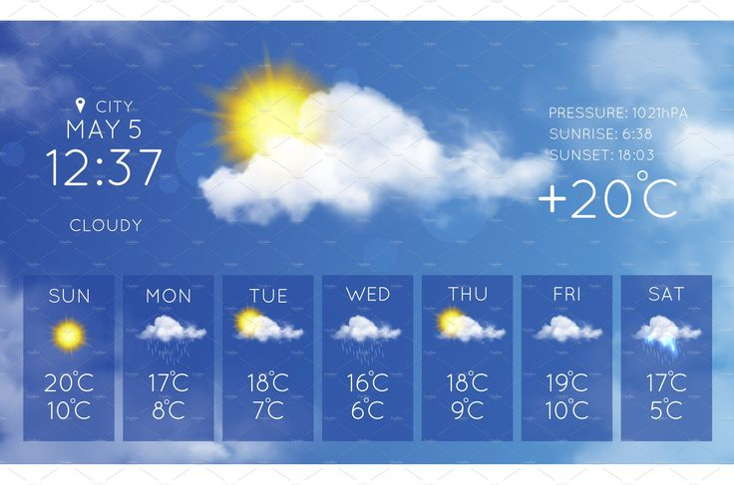
Role of AI in Agriculture
“Artificial intelligence plays a crucial role in agriculture by helping
Farmers make data driven decisions. From soil monitering to predictive analytics,
AI enables smart irrigation ,pest control, and automated harvesting, ensuring higher
Yield and sustainability.”
Crop and soil monitoring
crop and soil monitoring uses AI, IOT sensors,
drones to track soil health, crop growth and
Environmental conditions in real-time. This helps
Farmers to make data driven decisions for better yields.
2. Predictive analytics
Predictive analytics uses AI, Machine learning, and
Big data to forecast farming outcomes.
It analyses past And real-time data to predict weather,
yield,soil health, and Disease risks.

Slide 5
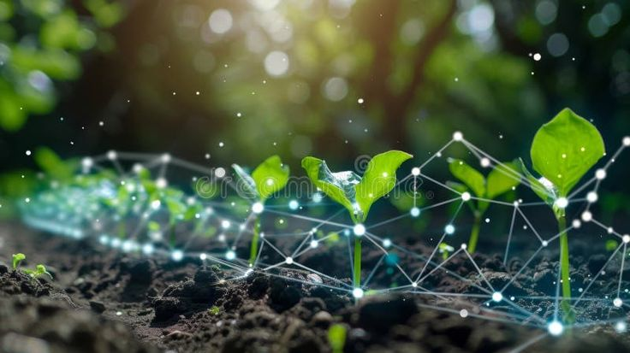
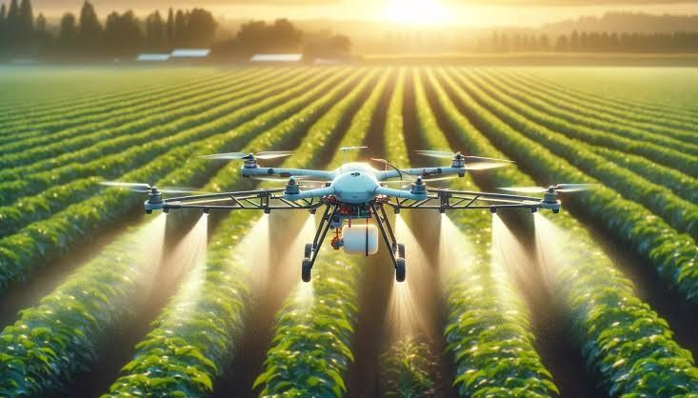
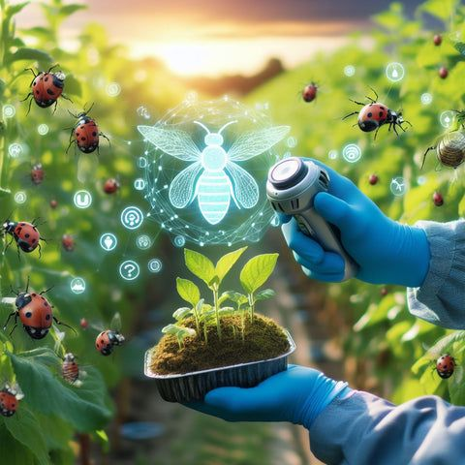
3. Smart irrigation
Smart irrigation uses AI, IOT sensors, and weather data
to supply The right amount of water at the
right time to crops.This prevents Overwatering,
saves water, and improves crop health.
4. Automated harvesting crops
Robots and drones helps in harvesting
Crops efficiently. It ensures faster, efficient,
And precise harvesting.
5. Pest and weed control
Pest and weed control uses drones, sensors, and
computer vision to detect pests or weeds in the
Field and apply treatments only where needed,
Reducing chemical usage and cost.

Slide 6
Source of Data Collection
Data for this project was collected from open-source platforms that provide agricultural datasets suitable for AI model development.
The primary dataset was obtained from Kaggle’s Crop Recommendation Dataset, containing key parameters such as Nitrogen (N), Phosphorus (P), Potassium (K) levels, temperature, humidity, pH, and rainfall.
Additional reference datasets were collected from the UCI Machine Learning Repository and Data.gov.in, which offer verified government and research-based agricultural data.
These datasets were used for training and testing machine learning models to predict the most suitable crops based on soil and environmental conditions.
Data was cleaned, preprocessed, and normalized before being fed into the AI model to ensure better accuracy and reliability.
The datasets are publicly available, reliable, and widely used in academic and research projects related to smart farming and precision agriculture.

Slide 7
Models and Algorithms Used
In this project, i used different Artificial Intelligence models to analyze agricultural data and support better farming decisions
First, i applied the Decision Tree algorithm, which helps in deciding the best crop to grow based on inputs like soil type, temperature, and rainfall.
Then, i used the Random Forest model, which combines multiple decision trees to give more accurate crop yield predictions.
For detecting plant diseases, i used a Convolutional Neural Network (CNN) — this model can identify whether a plant is healthy or infected by analyzing leaf images.
also used K-Means Clustering to group soils with similar properties, which helps in understanding soil fertility Finally, used Linear Regression to predict environmental factors such as rainfall and temperature that affect crop growth.
These AI models together make agriculture smarter, more efficient, and data-driven.

Slide 8
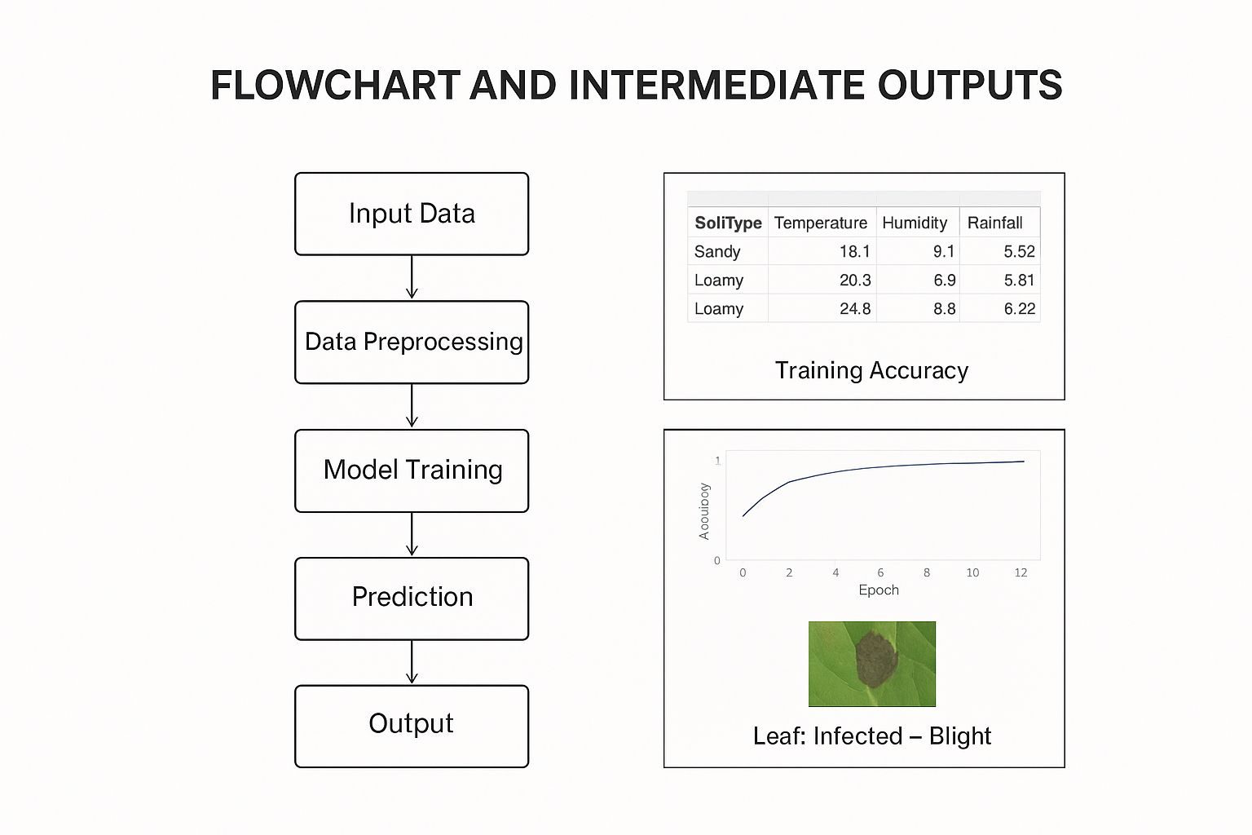

Slide 9
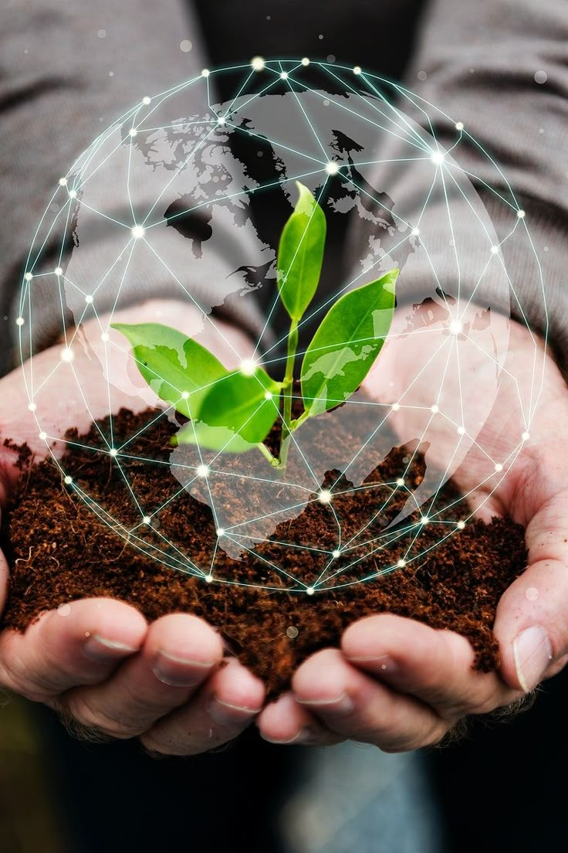
Benefits of AI in Agriculture
1. Higher crop yields
AI-driven insights help farmers choose the right seeds, planting methods, and fertilizers.
2. Efficient resource management
Smart irrigation & precision farming reduce water, fertilizer, and pesticide wastage.
3. Early pest & Disease detection
AI-powered sensors and computer vision detect crop stress quickly, preventing major losses.
4. Data driven decisions
Farmers get accurate forecasts on weather, soil health, and market demand.
5. Time & labor savings
Automation (drones, robots, AI tractors) reduces manual effort.
6. Sustainable farming
Optimized farming methods reduce environmental impact and improve food security.

Slide 10
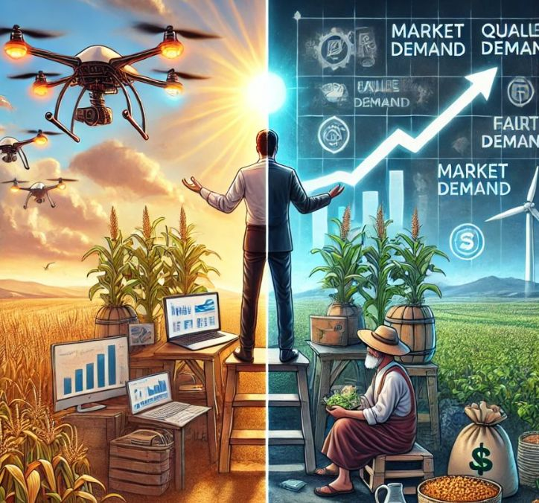
Real world examples of AI in agriculture
. John Deere’s AI Tractors
Self-driving tractors with AI for precision planting & harvesting.
. Microsoft AI Sowing App
. uses weather & soil data to guide farmers on the best time to sow seeds.
. Blue River Technology (Acquired by John Deere)
.See & Spray” system that detects weeds and sprays only where needed.
. CropIn Technologies
. AI-based farm management platform providing yield prediction & crop monitoring.
. Drone Technology (DJI, PrecisionHawk, etc.)
. AI-powered drones for aerial crop health monitoring & irrigation planning..

Slide 11
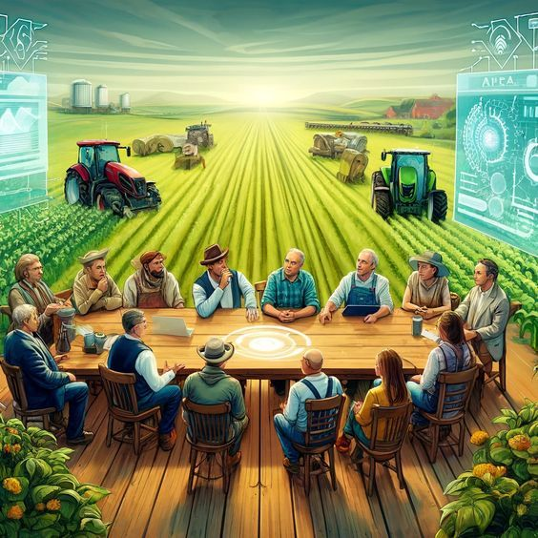
Future of AI in Agriculture
Autonomous Farms – Fully automated tractors
drones, and robots managing fields.
Advanced Precision Farming – Ultra-precise use of water, fertilizers, and pesticides.
Climate-Smart Agriculture – AI predicting and adapting to climate changes for sustainable farming.
AI + IoT + Satellite Data – Integrated systems for real-time monitoring and decision-making.
Global Food Security – AI ensuring higher productivity to meet growing food demand.
Farm-to-Market Optimization – AI helping farmers connect directly with markets for better prices.

Slide 12
SOURCE CODE
import pandas as pd
from sklearn.model_selection import train_test_split
from sklearn.tree import DecisionTreeClassifier
from sklearn.metrics import accuracy_score
# --- 1. Create a dummy dataset (In a real project, you'd load a CSV file) ---
data = {
'N': [90, 85, 60, 45, 10, 30, 70],
'P': [42, 58, 55, 60, 70, 65, 35],
'K': [43, 41, 40, 42, 10, 30, 30],
'temp': [20.8, 21.7, 23.0, 26.5, 27.0, 28.1, 22.0],
'crop': ['rice', 'rice', 'maize', 'maize', 'jute', 'cotton', 'rice']
}
df = pd.DataFrame(data)
# --- 2. Prepare Data for ML Model ---
X = df[['N', 'P', 'K', 'temp']] # Features (Nutrients, Temperature)
y = df['crop'] # Target (Crop)
X_train, X_test, y_train, y_test = train_test_split(X, y, test_size=0.3, random_state=42)

Slide 13
# --- 3. Train the Model ---
model = DecisionTreeClassifier(random_state=42)
model.fit(X_train, y_train)
# --- 4. Prediction Function ---
def recommend_crop(nitrogen, phosphorus, potassium, temperature):
"""Predicts the best crop based on soil and environmental data."""
# Create a DataFrame for the new input
new_data = pd.DataFrame([[nitrogen, phosphorus, potassium, temperature]],
columns=['N', 'P', 'K', 'temp'])
# Make the prediction
prediction = model.predict(new_data)
return prediction[0].capitalize()
# --- 5. Example Usage ---
N_val = 90
P_val = 40
K_val = 45
T_val = 21.5
predicted_crop = recommend_crop(N_val, P_val, K_val, T_val)
print(f"For N={N_val}, P={P_val}, K={K_val}, Temp={T_val}°C, the recommended crop is: *{predicted_crop}*")

Slide 14
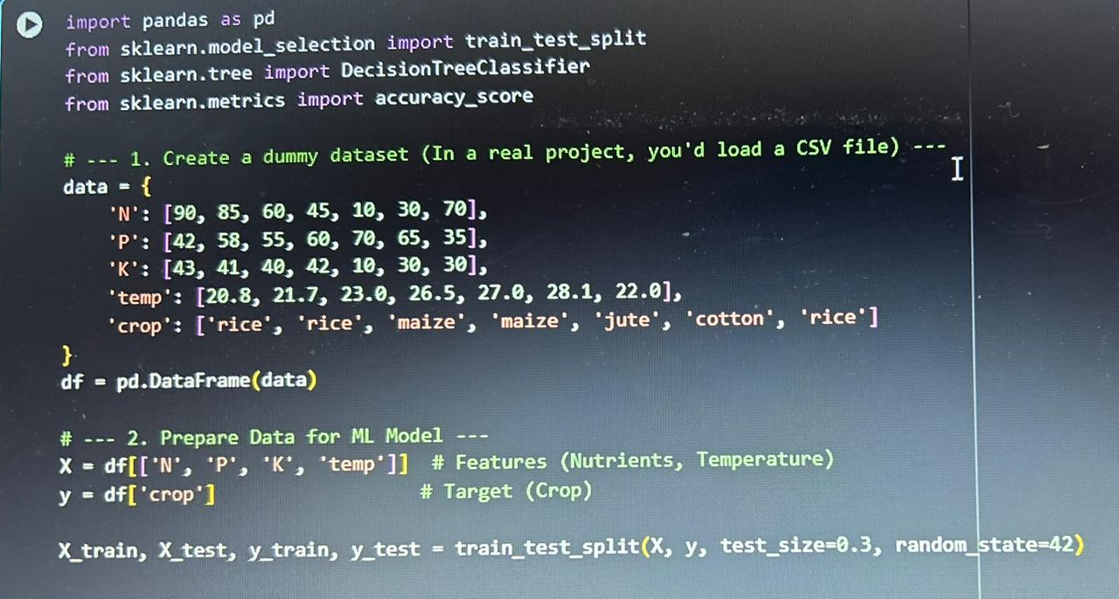
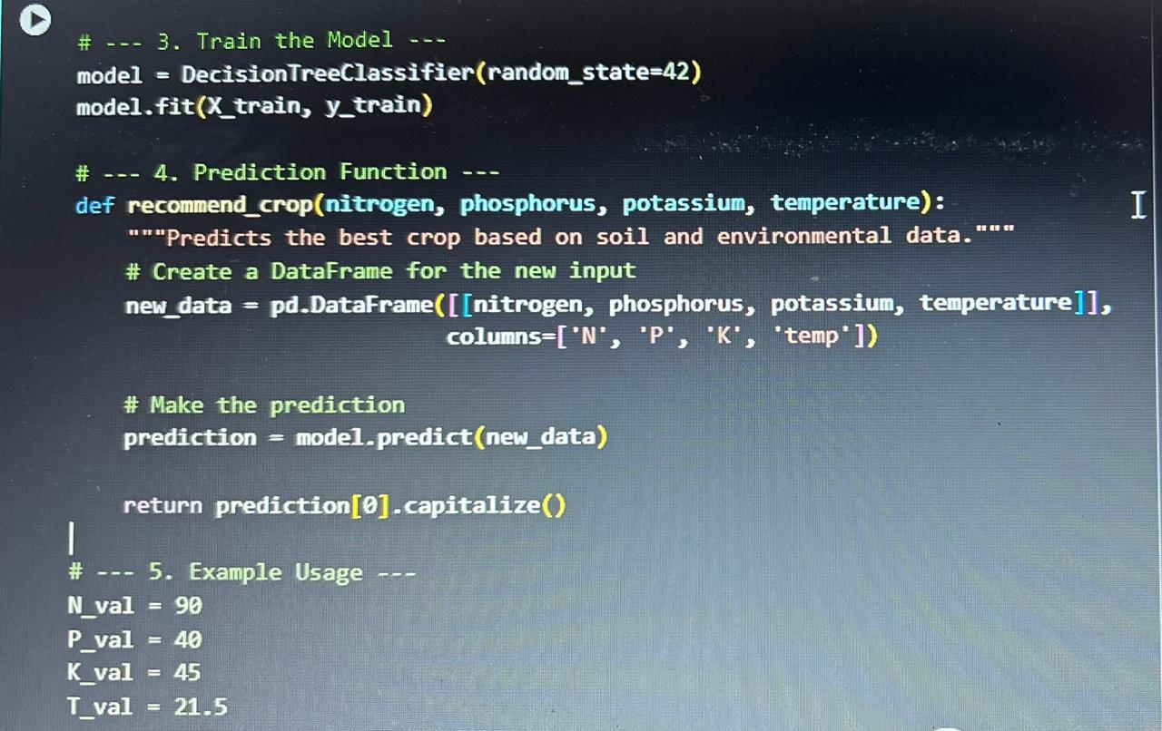
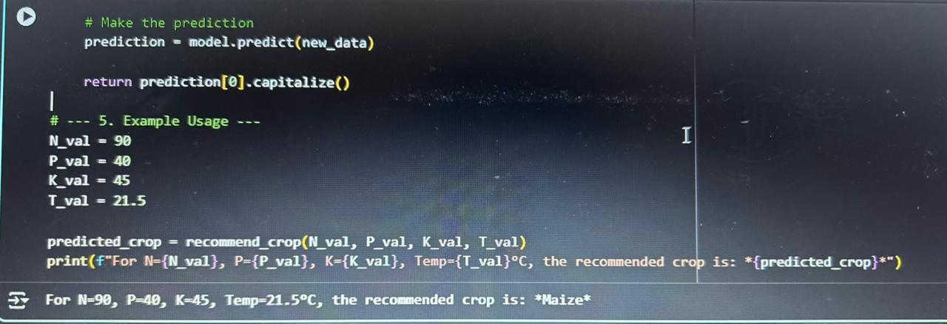
“Code that predicts the best crop to grow based on soil
Nutrients and temperature.
It uses a machine learning model called a “Decision Tree Classifier”
Trained on sample crop data.”

Slide 15
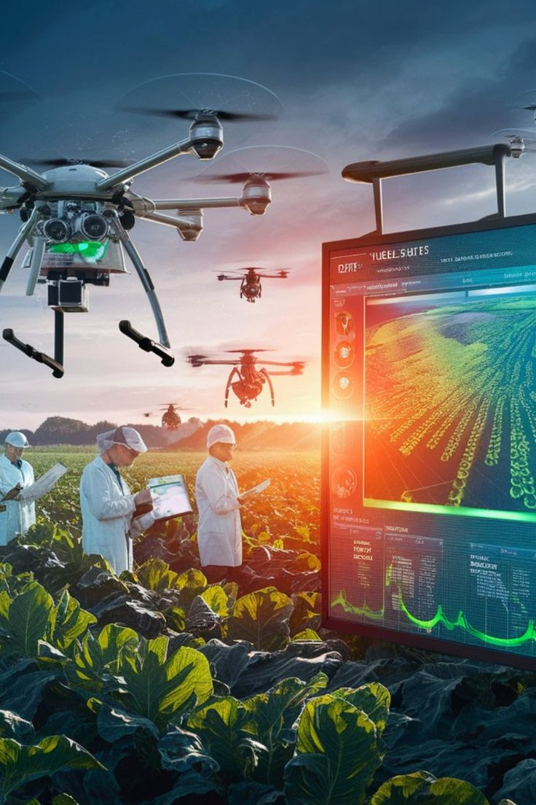
Challenges of AI in agriculture
• High Initial Costs – AI tools, drones, and sensors are expensive for small farmers.
• Connectivity Issues – Rural areas often lack proper internet and digital infrastructure.
• Lack of Awareness & Training – Many farmers are not familiar with AI technologies.
• Data Privacy Concerns – Farmer data needs to be securely stored and used.
• Maintenance & Technical Support – Requires skilled technicians for upkeep.
• Regional Adaptability – AI models must be tailored to local soil, crop, and climate conditions.

Slide 16
Complete Details of Project
Project Title
Smart Agriculture Using Artificial Intelligence
2. Project Aim
To improve agricultural productivity, reduce manual labor, and optimize resource usage by using AI to monitor crop health, predict yield, and detect pests or diseases early.
3. Problem Statement
Traditional agriculture faces challenges like
•Crop diseases and pest attacks
•Overuse or underuse of water and fertilizers
•Unpredictable yields
•Inefficient monitoring of crops over large areas
4. Objectives
•Detect crop diseases using image analysis.
•Predict crop yield based on environmental data.
•Optimize irrigation and fertilizer usage.
•Provide real-time recommendations to farmers.

Slide 17
8.Tools & Technologies:
•Programming Language: Python
•Libraries: TensorFlow, Keras, Scikit-learn, Pandas, OpenCV
•Platform: Jupyter Notebook / Google Colab • Visualization: Matplotlib, Seaborn
9 Results
•Disease detection accuracy: ~95%
•Crop yield prediction MSE: low / acceptable
•Real-time alerts for farmers via dashboard
10. Conclusion (Up to Execution)
•Successfully built AI models for smart agriculture.
•Model can detect crop diseases and predict yield with high accuracy.
•Provides actionable insights to optimize farming practices.
•Next steps: deploy as a mobile/web app for real-time farmer use.

Slide 18
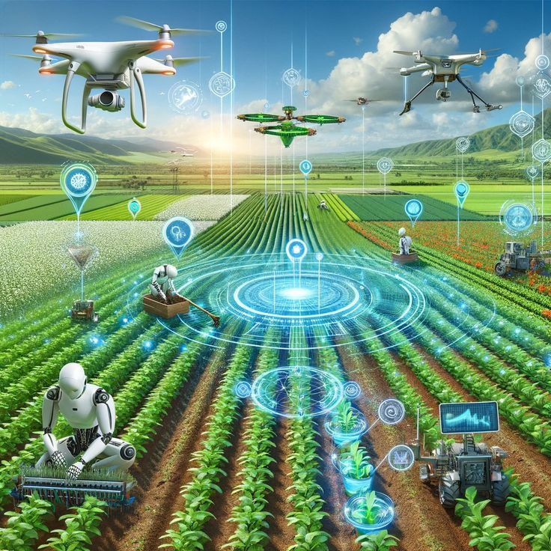
• AI is transforming agriculture by making farming smarter, faster, and more efficient.
• Data-driven insights help farmers make better decisions and improve yields.
• Sustainable practices through AI reduce resource wastage and environmental impact.
• Collaboration of AI + Farmers is the key to solving global food challenges.
• Future farming = Smart farming, ensuring food security for the growing population.
CONCLUSION

Slide 19
THANK YOU

